Slide 1
RANT-2-RESOLVE
TEAM: Error 404

Slide 2
Problem and Motivation
Real-Time Student Issue Reporting and Resolution Platform
Students lack a centralized system to report issues in real time
Existing processes are manual, slow, and non-transparent
No proper tracking, prioritization, or accountability
Our Goal
Enable students to report issues instantly
Provide real-time status updates
Ensure transparent and accountable resolution
Outcome
A structured digital platform connecting students and authorities efficiently.

Slide 3
SOLUTION OVERVIEW
Rant-2-Resolve is a role-based web platform for students and administrators.
What It Provides:
Issue raising & tracking
Public announcements
Private academic support
Innovation:
Combines grievance management + opportunity awareness in one platform.

Slide 4





Technology Stack
HTML
CSS
JavaScript
Express.js
React.js
Node.js
MongoDB
Lightweight backend framework for handling APIs and application logic.
Frontend library for building user interfaces
JavaScript runtime for server-side development
NoSQL database for data storage and management

Slide 5
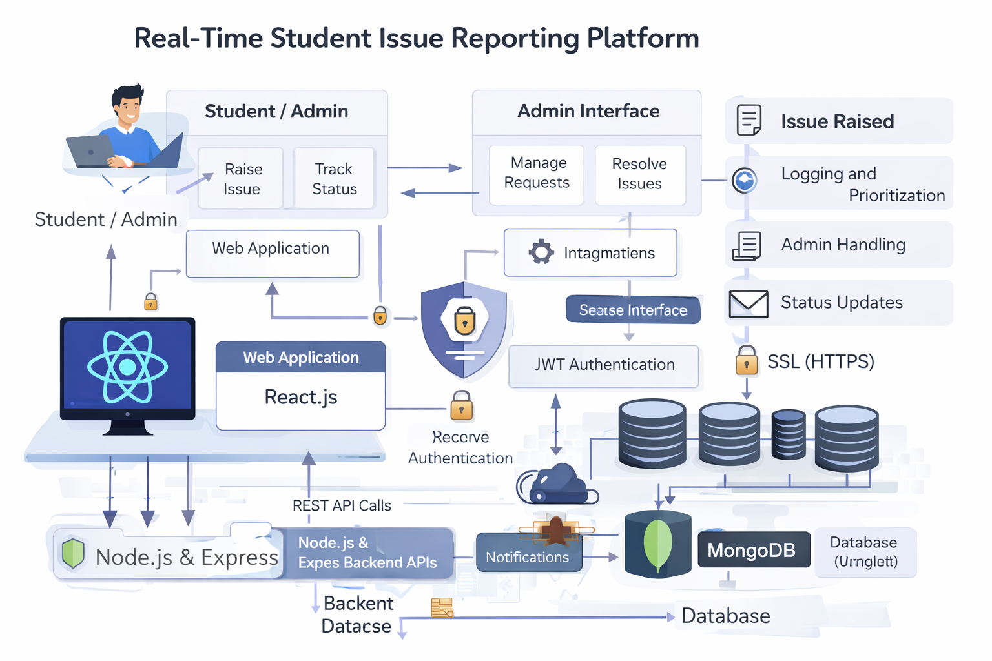
Technology Architecture
Architecture Flow
Student / Admin
→ Web Application (React)
→ Backend API (Node.js & Express)
→ Database (MongoDB)
→ Status Updates & Resolution

Slide 6
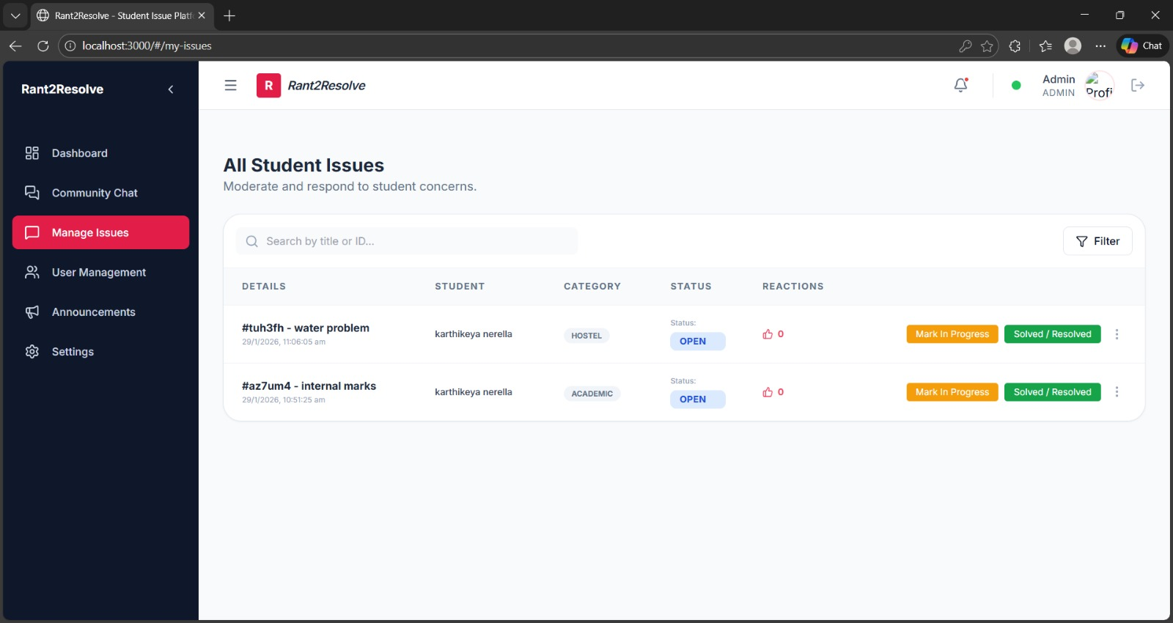
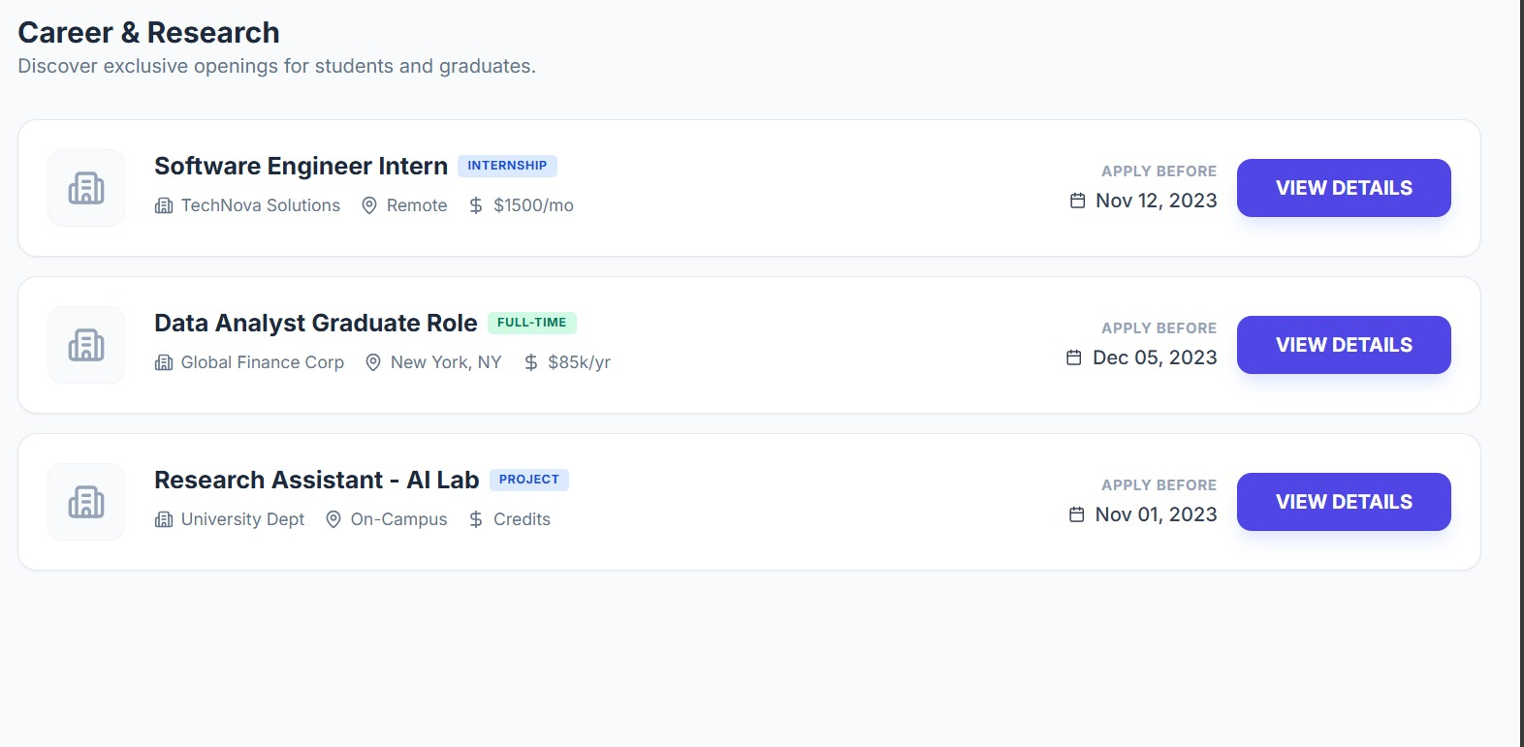
Implementation and Results
Implemented Features
User authentication
Issue submission module
Status tracking system
Admin resolution dashboard
Result
A functional prototype
enabling real-time issue reporting and resolution.

Slide 7




Conclusion and Future Scope
Rant-2-Resolve improves transparency, efficiency, and accountability in student issue management.
File Uploads
Notifications
Mobile App
Analytics
Allow users to attach documents easily
Instant updates via email and SMS alerts
Dedicated app for on-the-go access
Dashboard for monitoring trends and insights

Slide 8
Thank You
WEBSITE
www.rant2resolve.com
Thank You for Your Attention and Questions
EMAIL
rant2resolve @yahoo.com
PHONE
+91 7032901177

